Slide 1
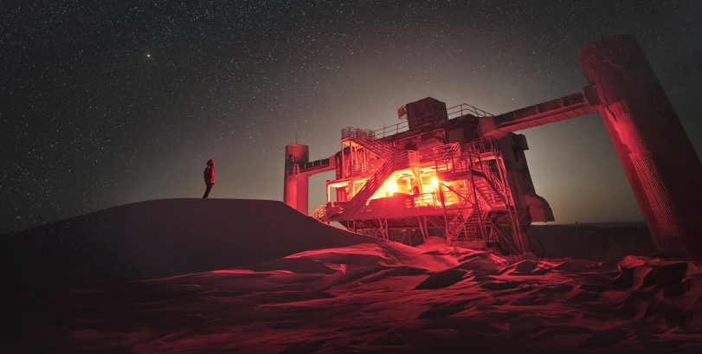
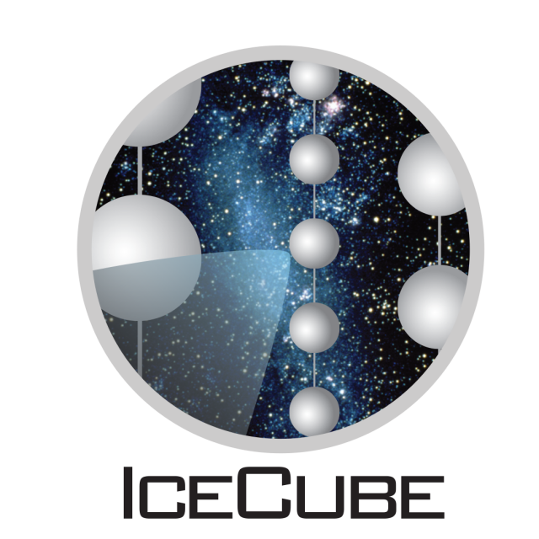
IceCube Masterclass Mercer University - 2022

Slide 2
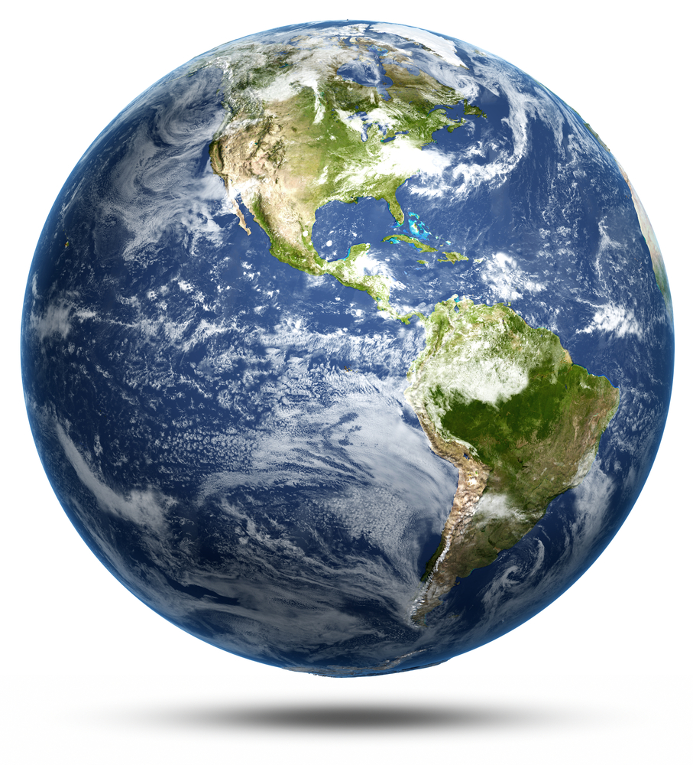
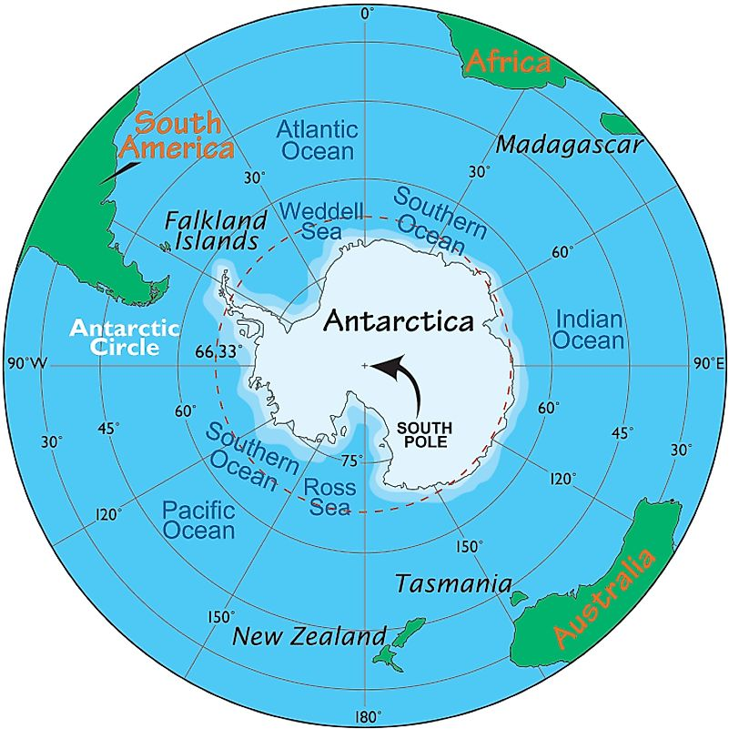
The Geographic South Pole
Here!
About 1.5 the area of the USA.
Covered almost entirely by a thick (2 mile average) ice cap
There is bedrock under the ice.
Typical elevation: 2 miles
Fully surrounded by ocean
Very, very dry – about the same precipitation/year as the Sahara.

Slide 3
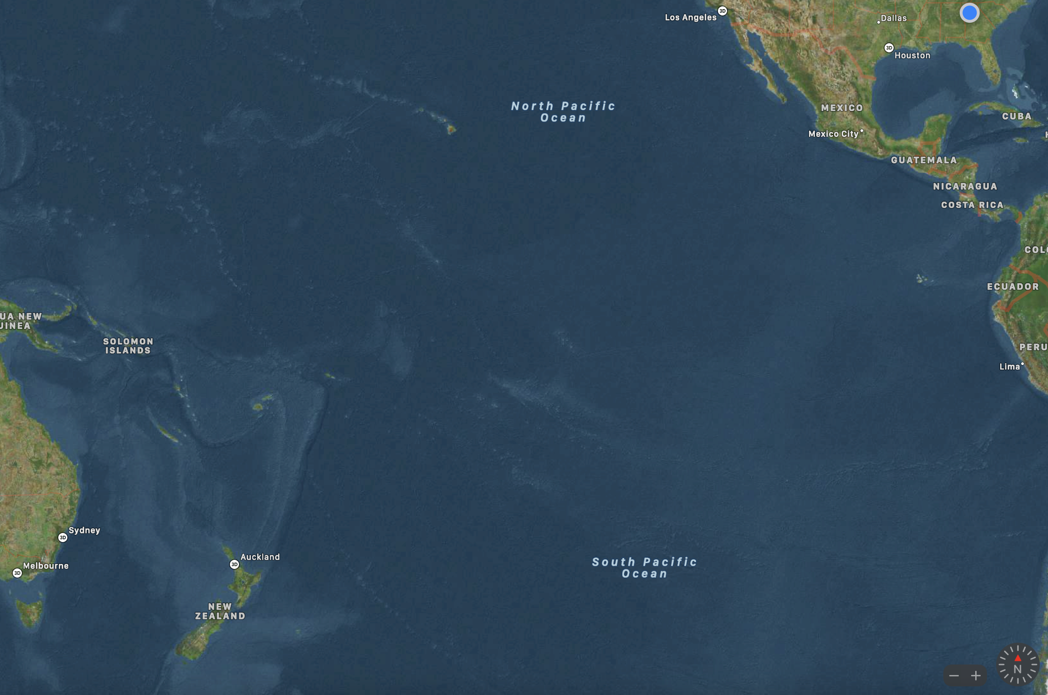
How to get to South Pole Christchurch NZ
5 hr
13 hr
1 hr

Slide 4
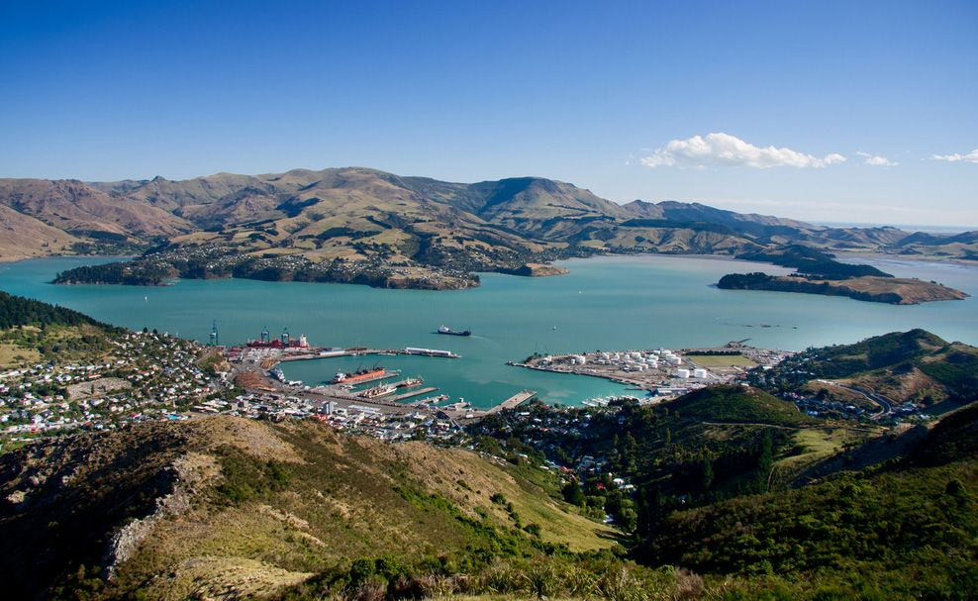
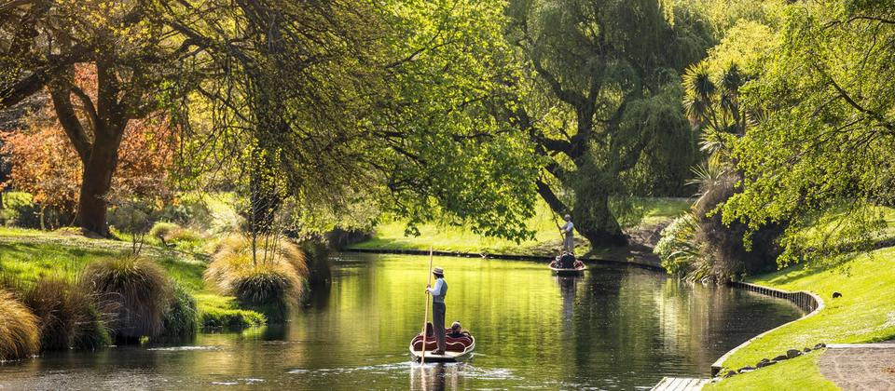
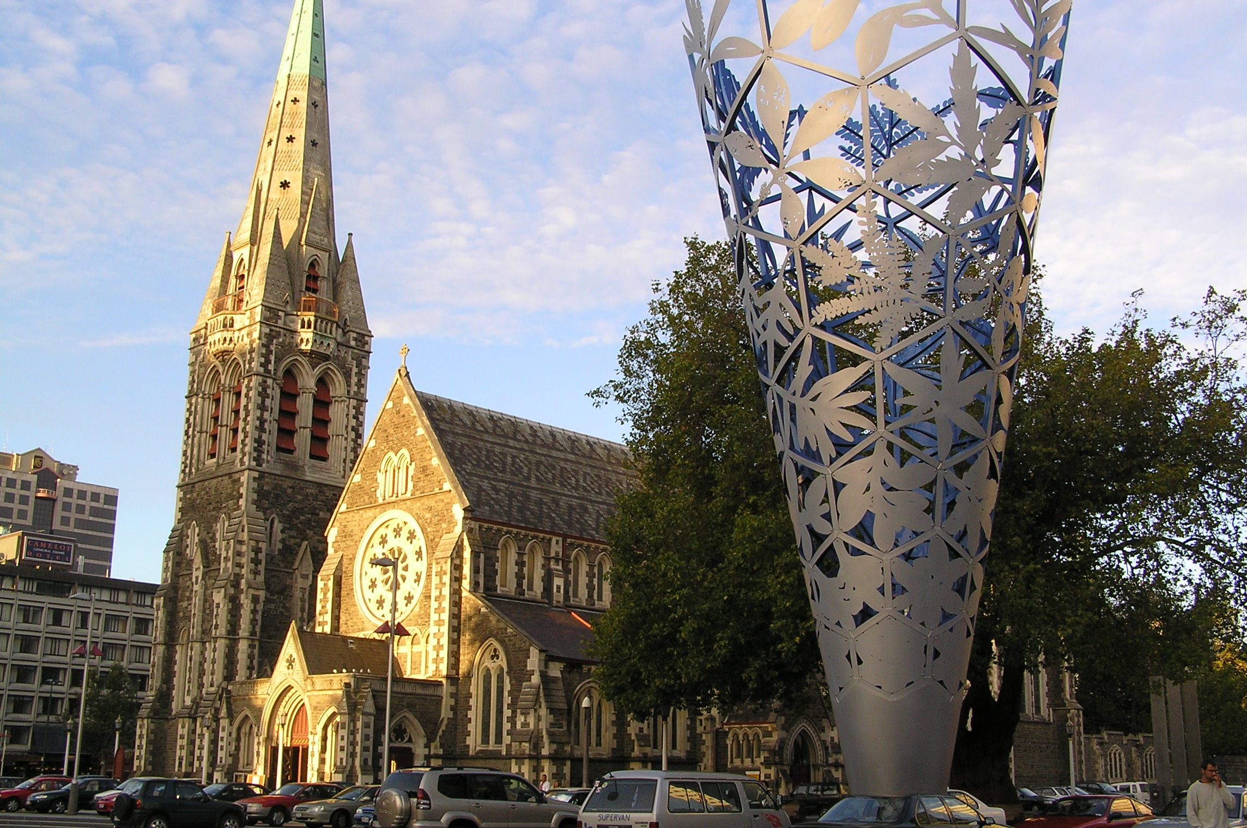
Christchurch NZ
Pop. 350,000 Largest city in Southern Island

Slide 5
How to get to South Pole
5 hr (C130,Bassler)
5 hr (C17) 8 hr (C130)
McMurdo Station

Slide 6
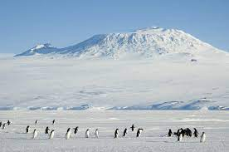
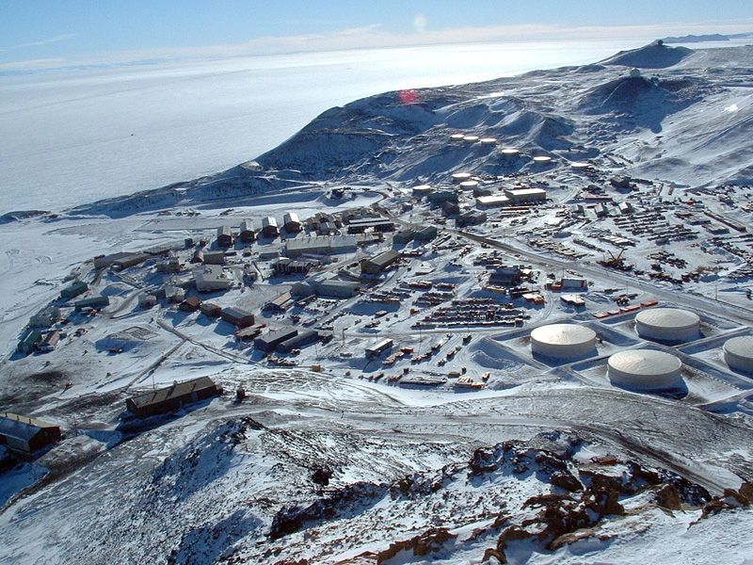
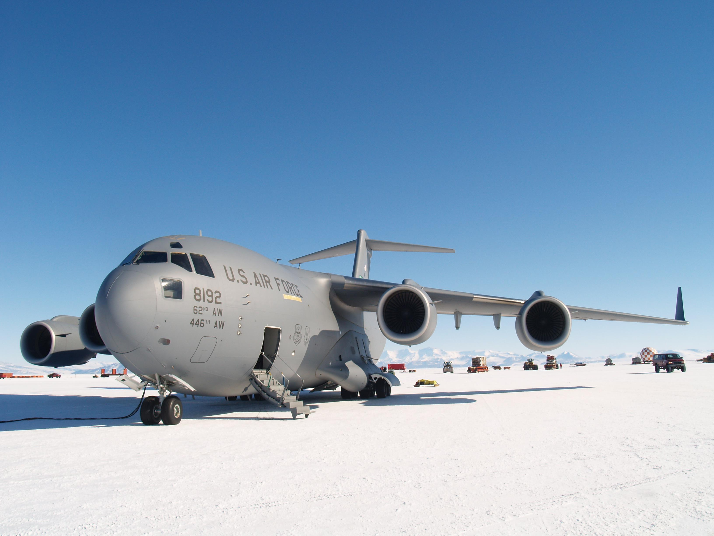
McMurdo
Mt. Erebus Active Volcano
C17
Population: 1250 (summer) / 300 (winter)
Southernmost point in the world reachable by ice breaker
I’ve never seen a penguin in McMurdo, but I’ve seen seals and skuas
Temperature -9 F (August) to 30 F (January)
South of the Antarctic Circle (6 month day, 6 month night)

Slide 7
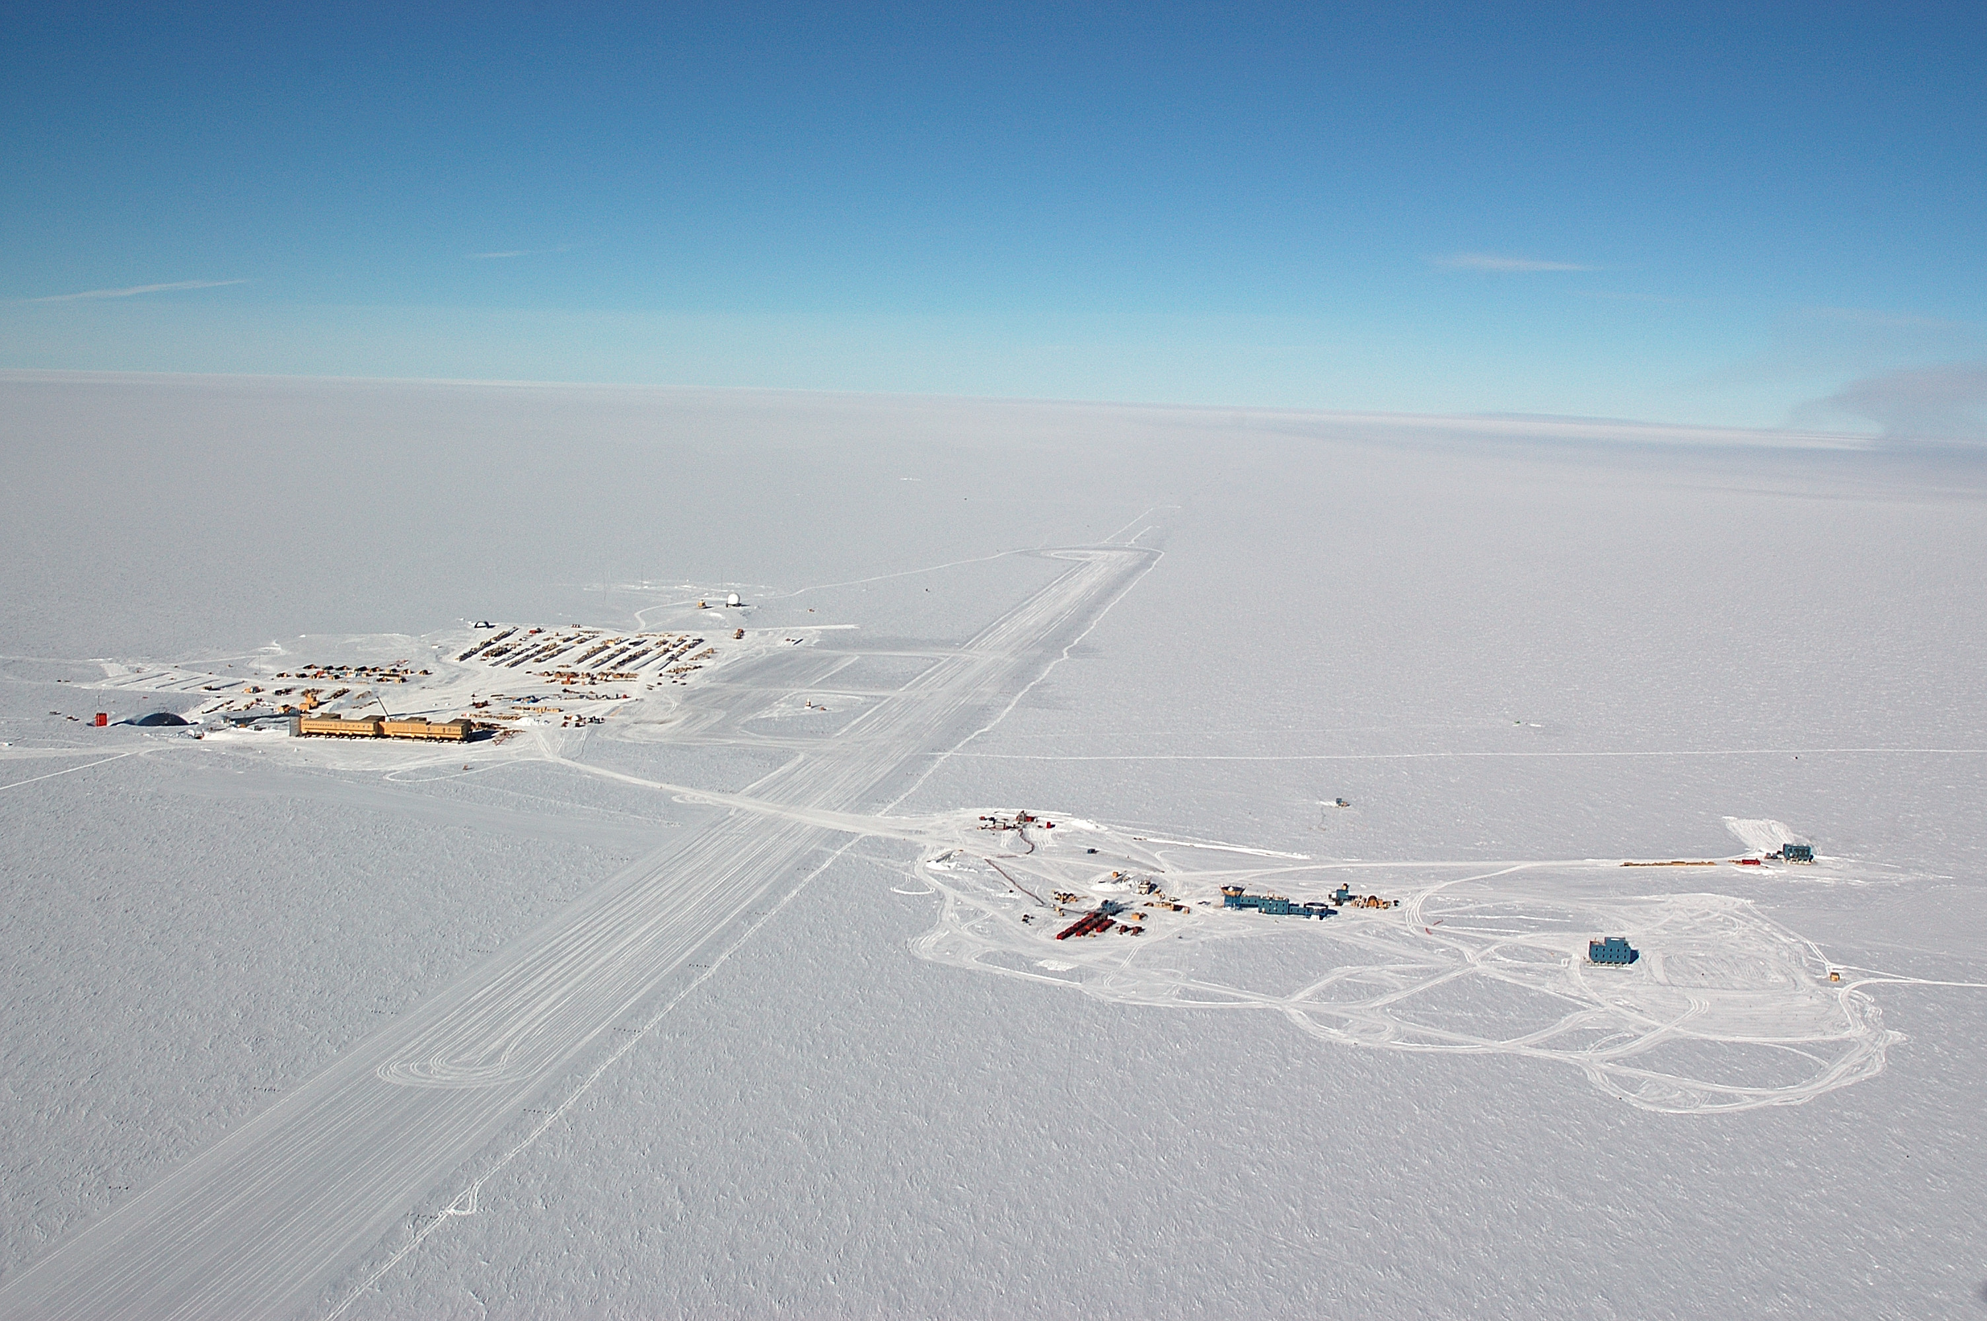
Geographic
South Pole
Satellite / Communication Antennas
IceCube footprint
Clean Air Sector
skiway
MAPO
IceCube Laboratory
South Pole Telescope
Dark Sector

Slide 8
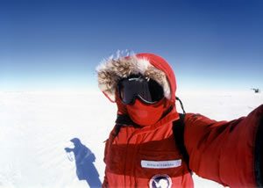
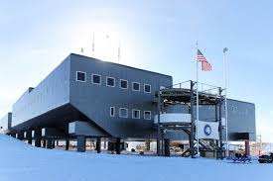
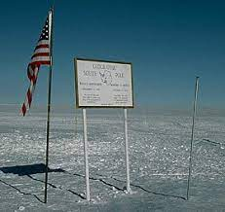
South Pole
How you actually are dressed outside
Amundsen-Scott Station
Population: 150 (summer) 50 (winter) Elevation: 9300’ -20 F (January) to -76 F (August) Summer, Nov 1 to Feb 10, is warmer than -50F
I’ve been there 3 times. Each time for about a month.
Hearty meals: good for cold and morale
”The” South Pole

Slide 9
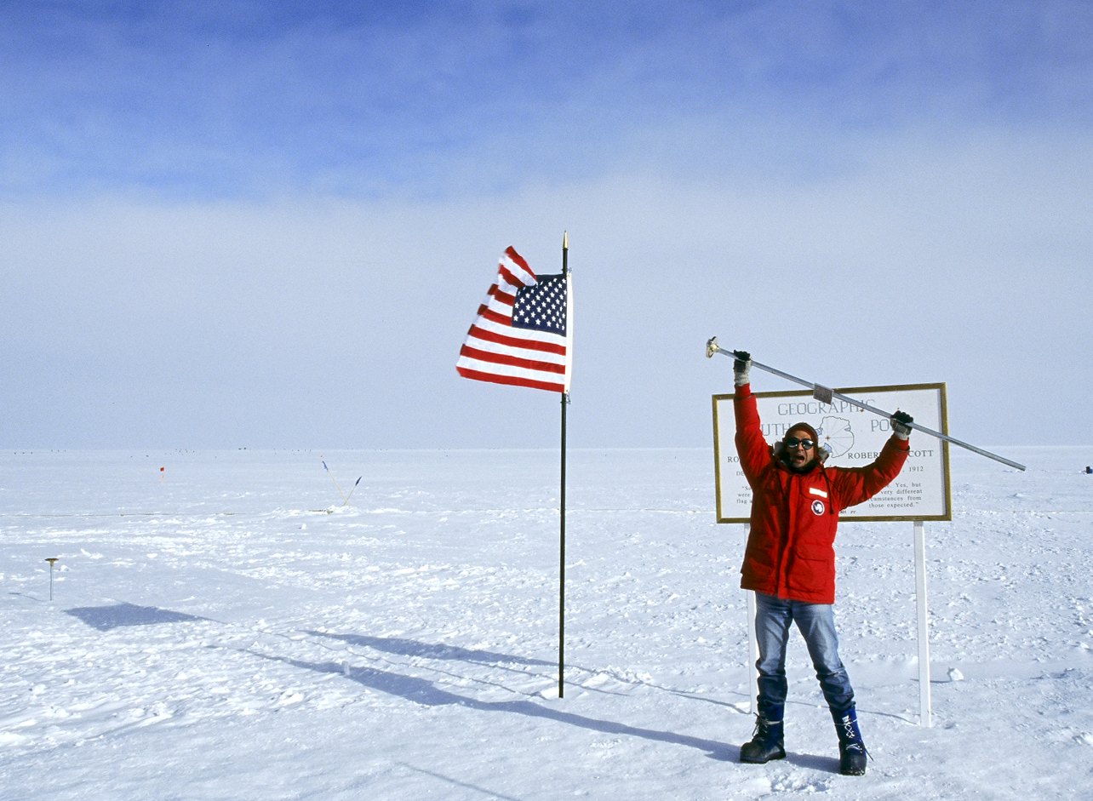
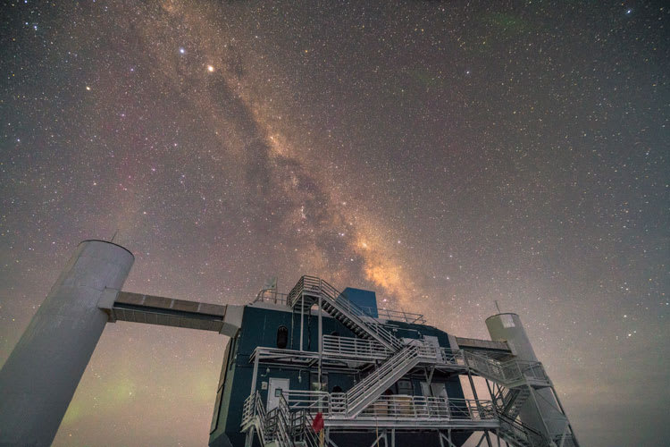
More South Pole Pictures
Prev. year marker
I have removed the axis of rotation of the planet!
The IceCube Laboratory and the Milky Way at South Pole

Slide 10
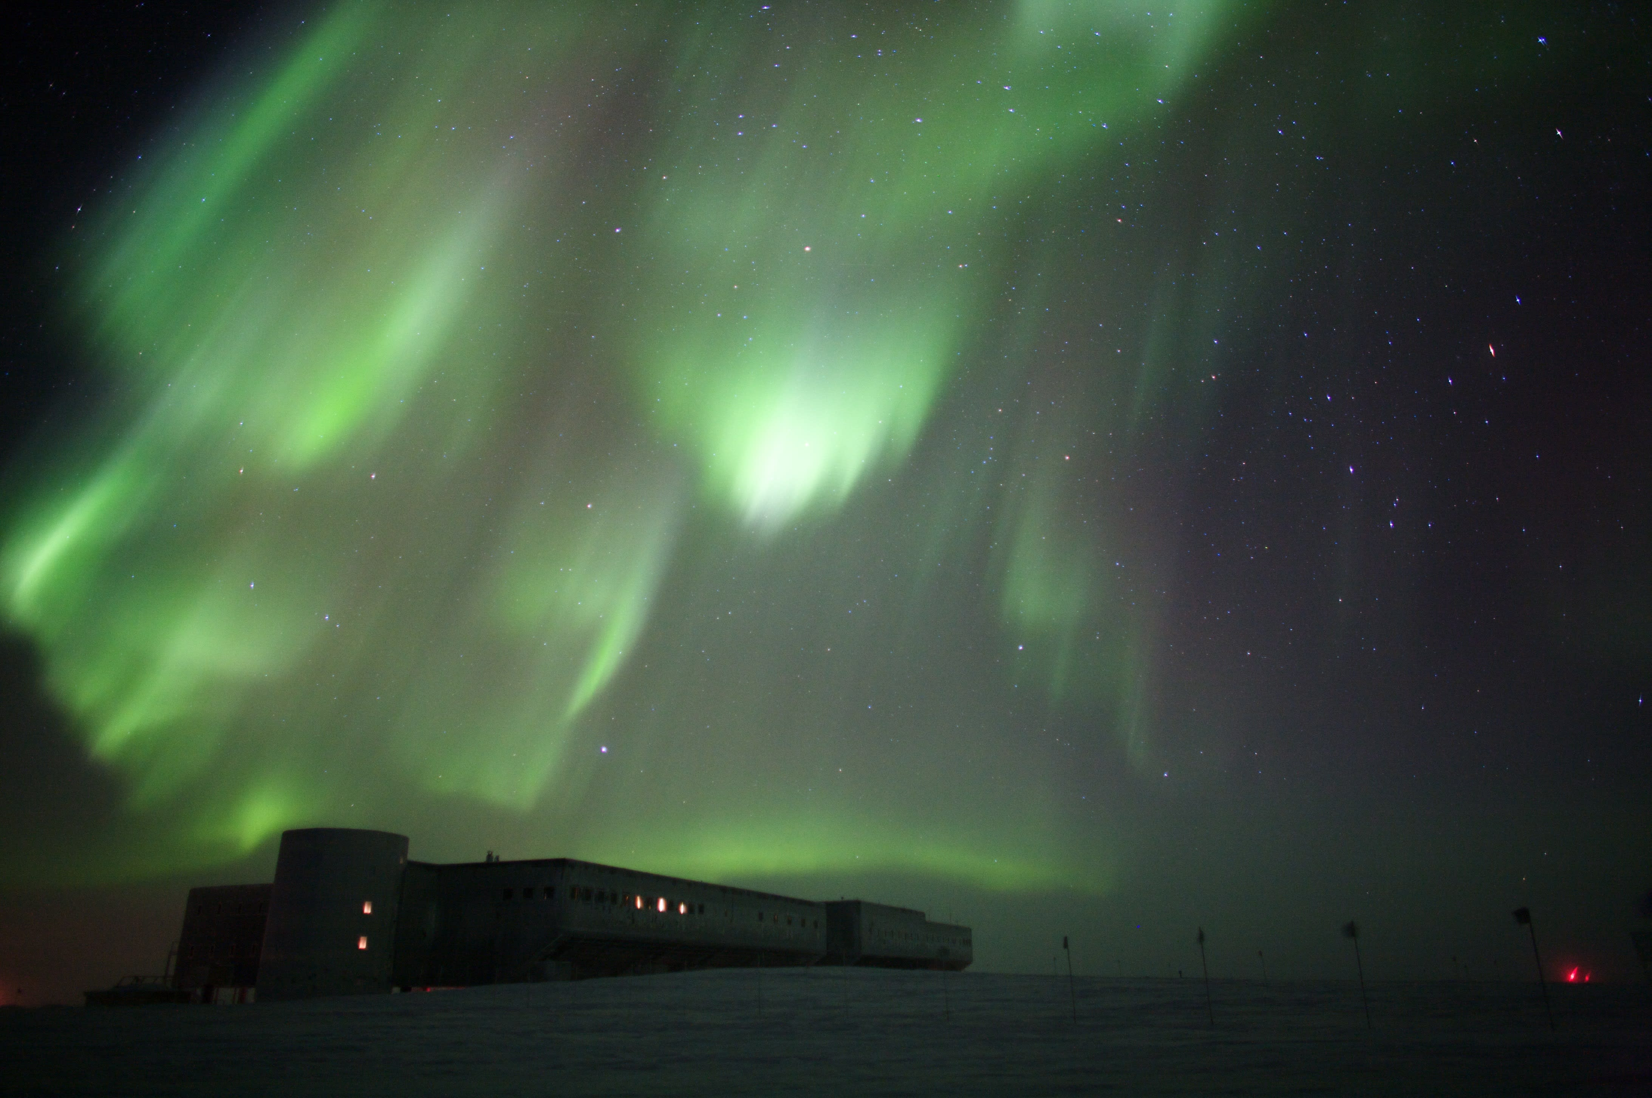
Auroras Australis at South Pole

