Slide 1
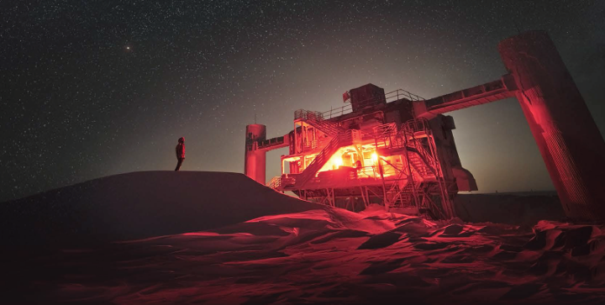
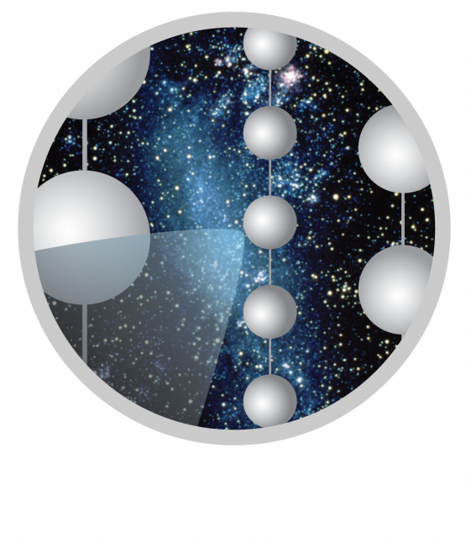
IceCube MasterClass
Georgia Tech - 2023

Slide 2
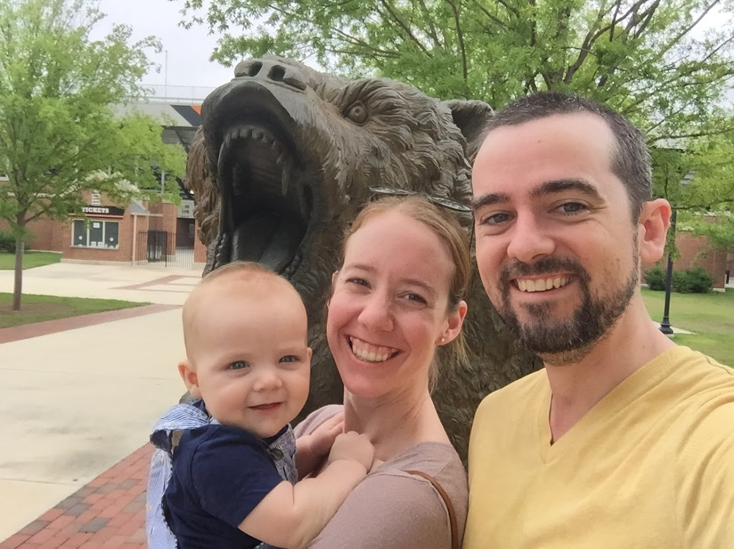
Meet the Team: Frank McNally
Assistant Professor of Physics at Mercer University
Education:
BA Physics, 2009 Carleton College, Northfield MN
PhD Physics, 2015 U. Wisconsin - Madison, Madison WI
Research Interests:
Particle Astrophysics, Cosmic Rays and Machine Learning
IceCube 2006 - present
Hobbies:
Video games, ultimate frisbee

Slide 3
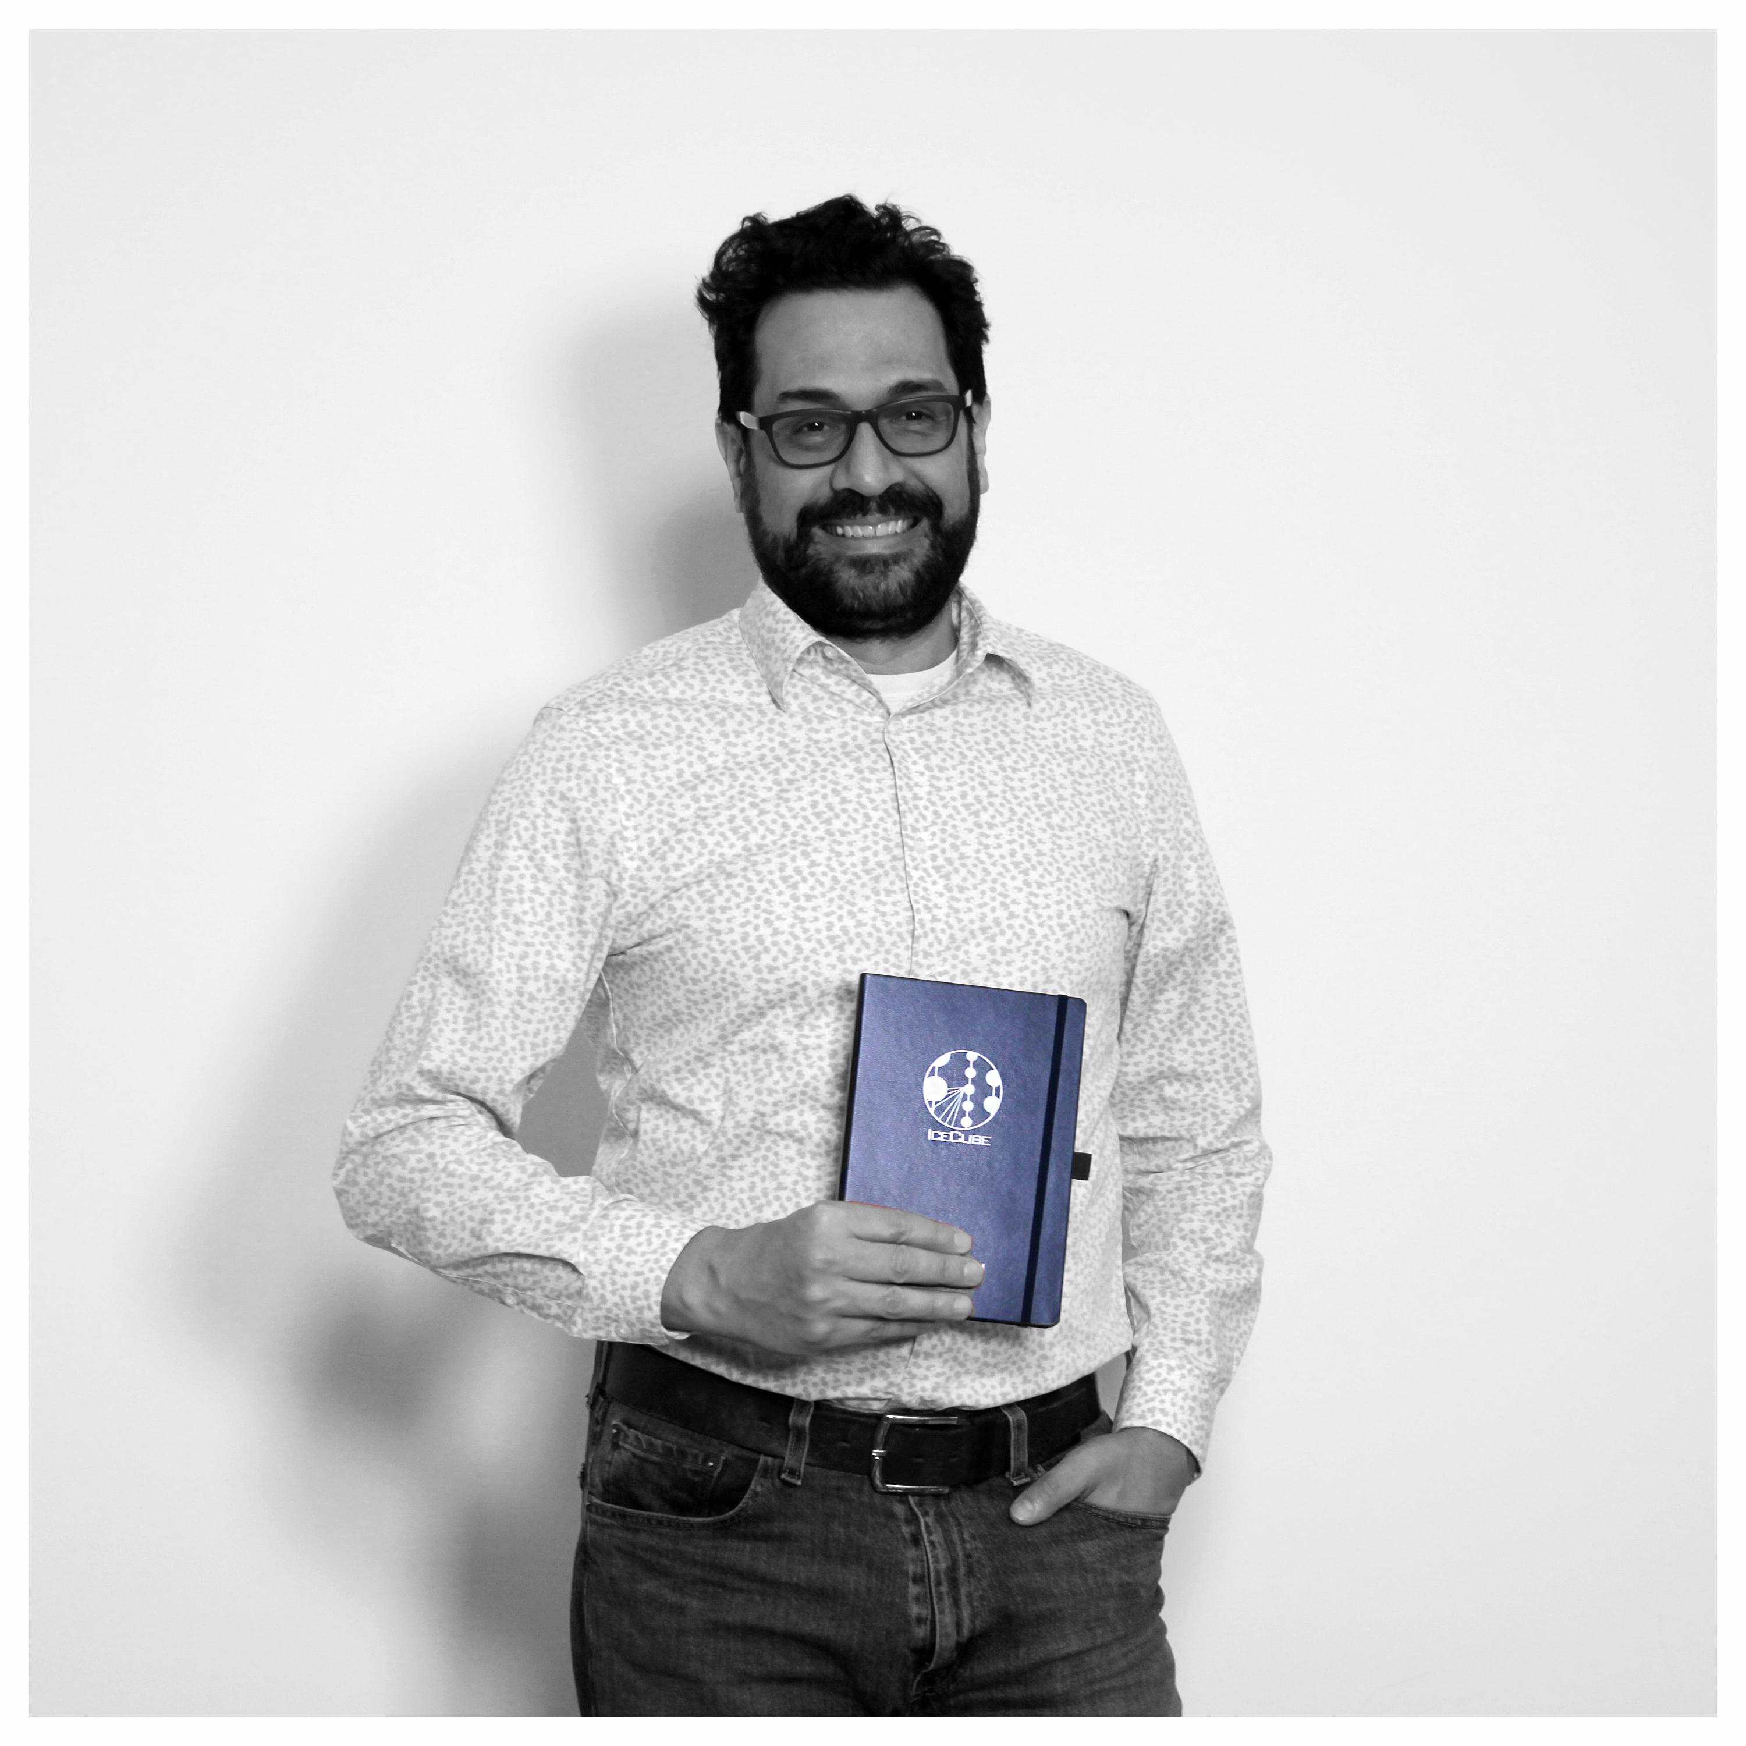
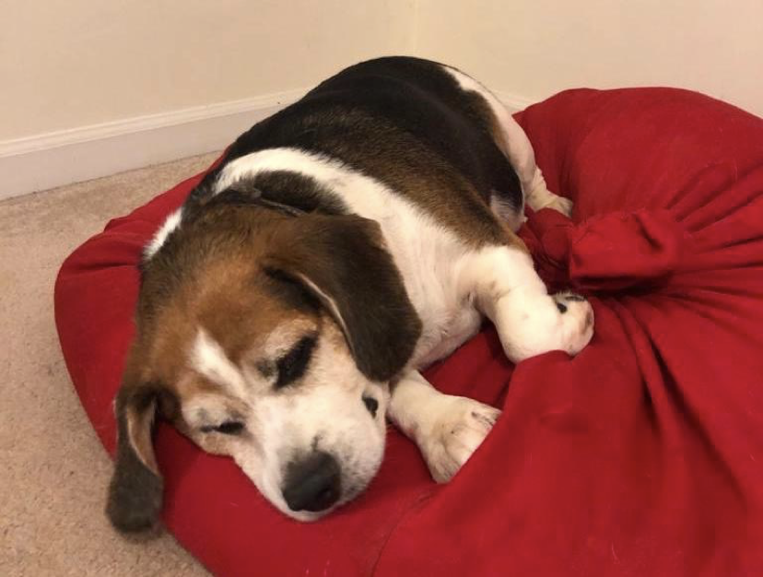
Meet the Team: Ignacio Taboada
Professor of Physics at Georgia Tech
Education:
BSc Physics, 1994 U. Simón Bolívar, Venezuela
PhD Physics and Astronomy, 2002 U. Pennsylvania, Philadelphia PA
Research Interests:
Particle Astrophysics
IceCube (1998 – present)
AMANDA (1998 – 2005), HAWC (2009 – 2017), TRINITY (2020 – present), P-ONE (2022 – present)
Hobbies
Piano, hiking

Slide 4
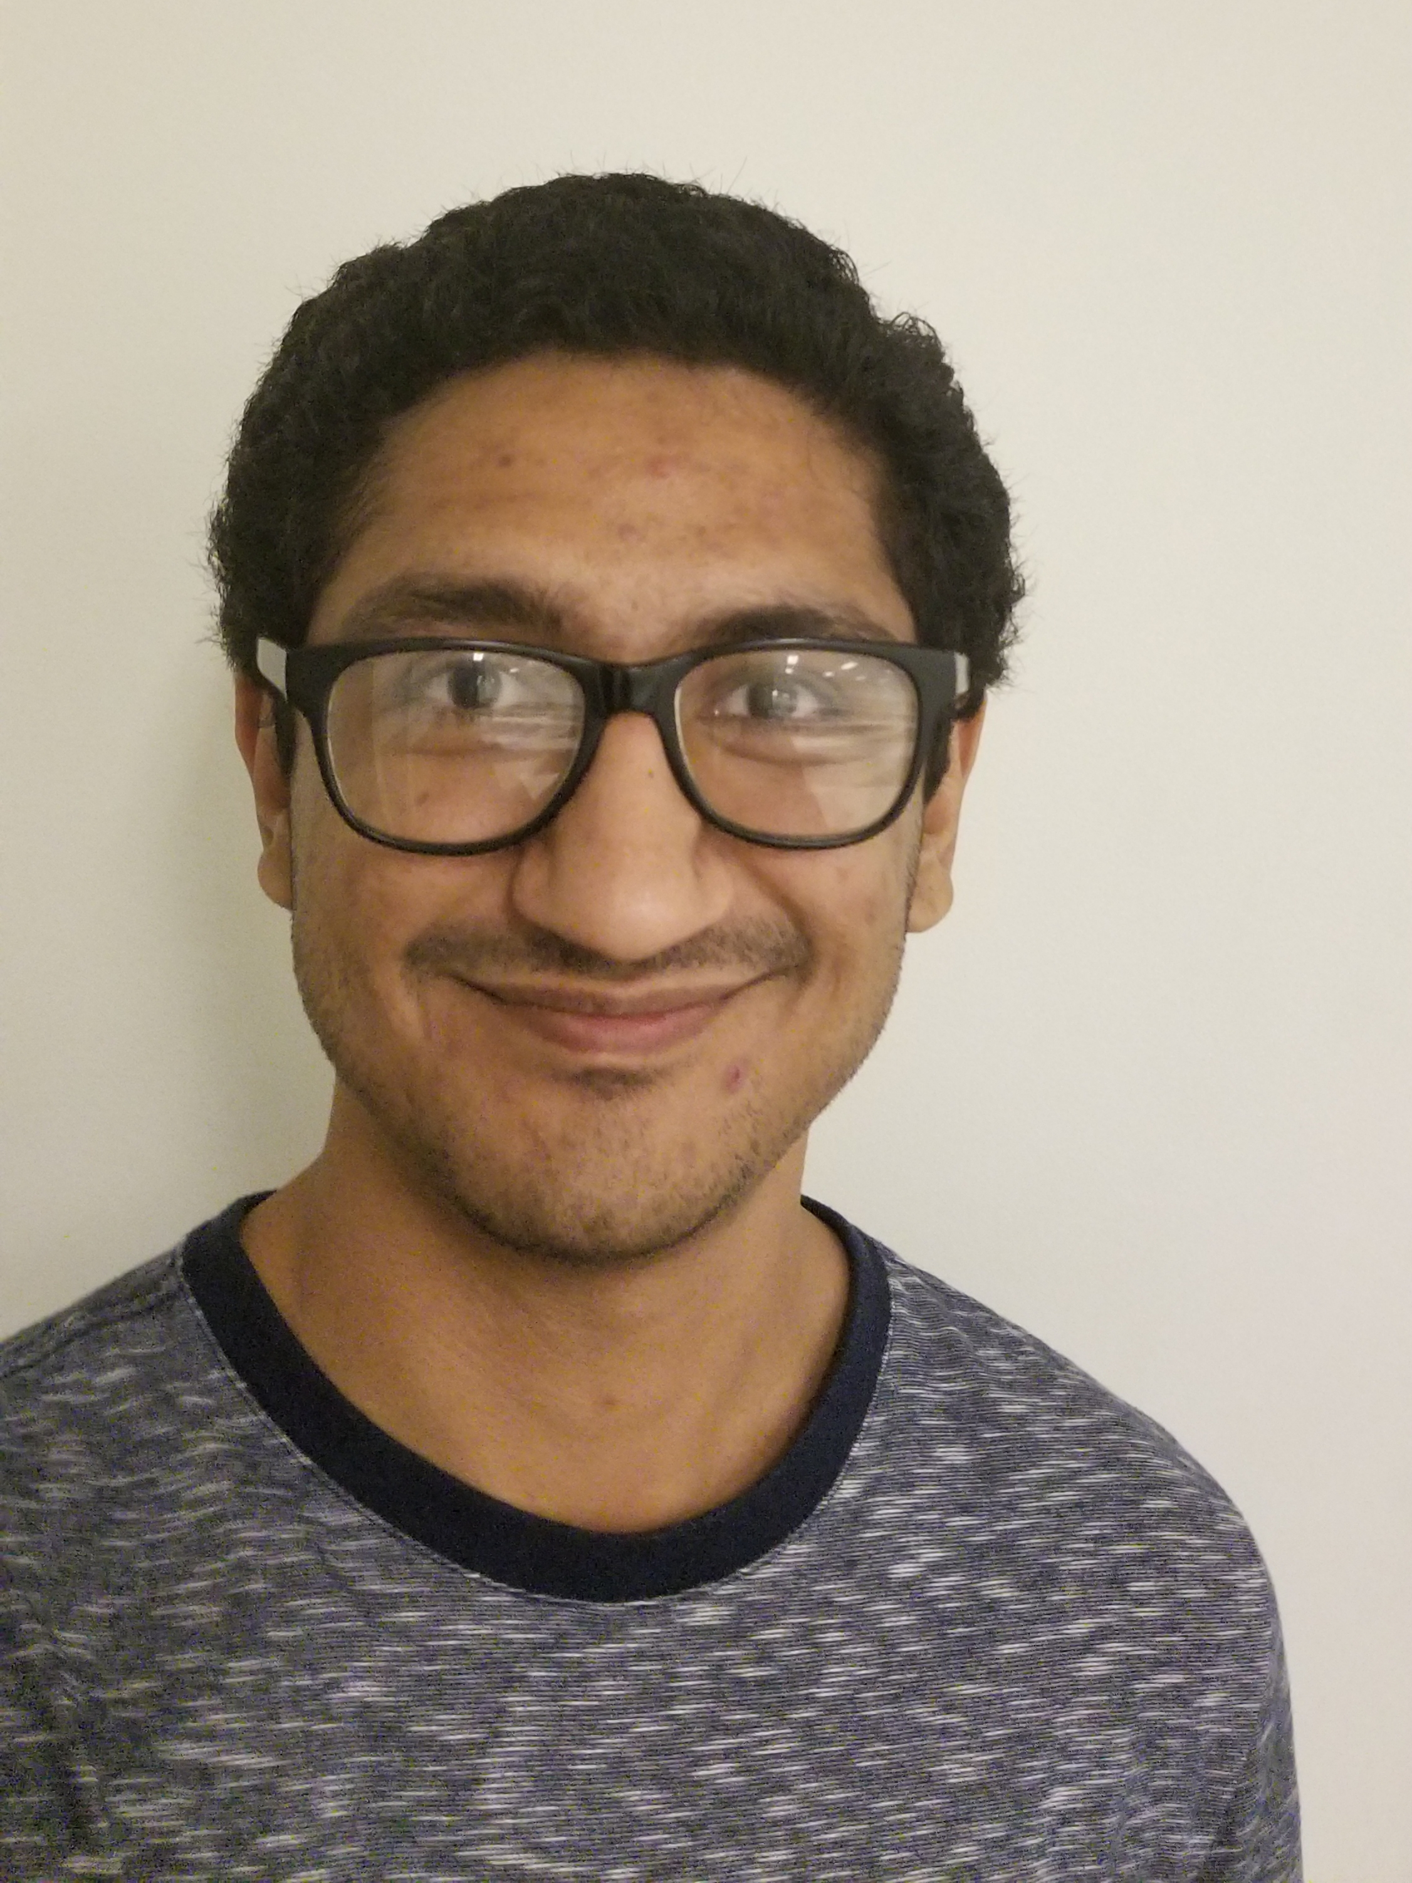
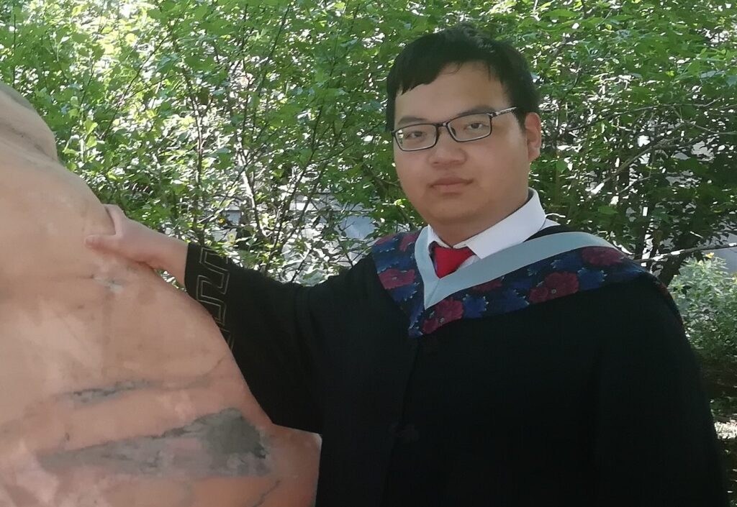
Meet the Team
Dr. Pranav Dave
Bennett Brinson
Jiyuan Liao
Andrew Wang

Slide 5
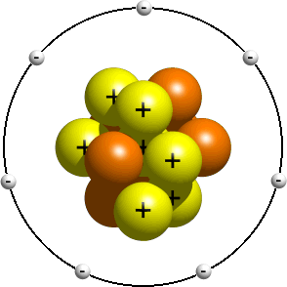
Atoms and Subatomic particles
Subatomic particles that you know about: electrons, protons, neutrons
Electrons have negative charge: -e Protons have positive charge: +e Neutrons have no charge: 0
There are many, many more subatomic particles.
Cartoon of a nitrogen atom

Slide 6
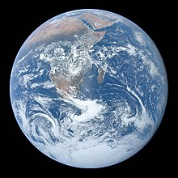
Neutrinos – ssubatomic particles – are “ghost-like”
90% of light goes through
Pane of glass
> 99.9999% of neutrinos go through

Slide 7
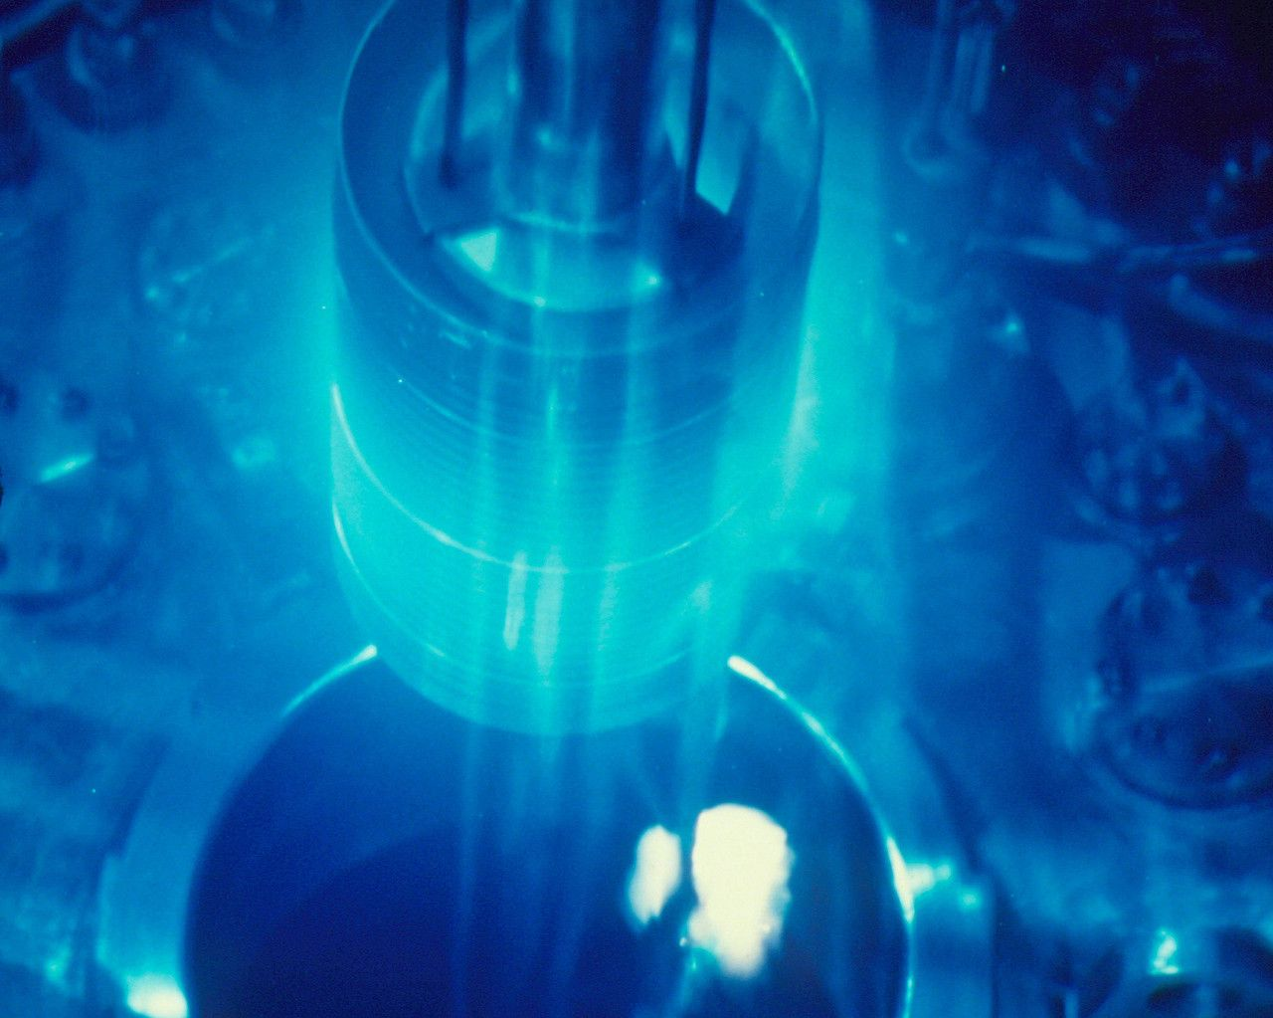
Detecting particles in Ice
When high-energy charged particles pass through a medium, they emit light
Optical equivalent of sonic boom!
Core of a nuclear reactor
Notes:
Optional: Cherenkov radiation

Slide 8
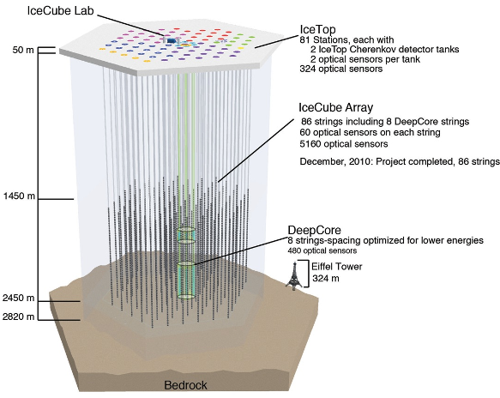
IceCube
In-Ice “IceCube” to detect high-energy neutrinos
In-Ice “DeepCore” to detect lower energy neutrinos
Surface “IceTop” to detect cosmic rays
Notes:
Optional: Cherenkov radiation

Slide 9
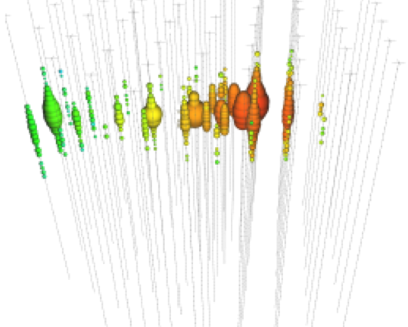
Detecting Neutrinos
An astrophysical neutrino detected by IceCube
Other Particles
Muon
Neutrino
Nucleus Example: Oxygen
Notes:
Optional: Cherenkov radiation

Slide 10
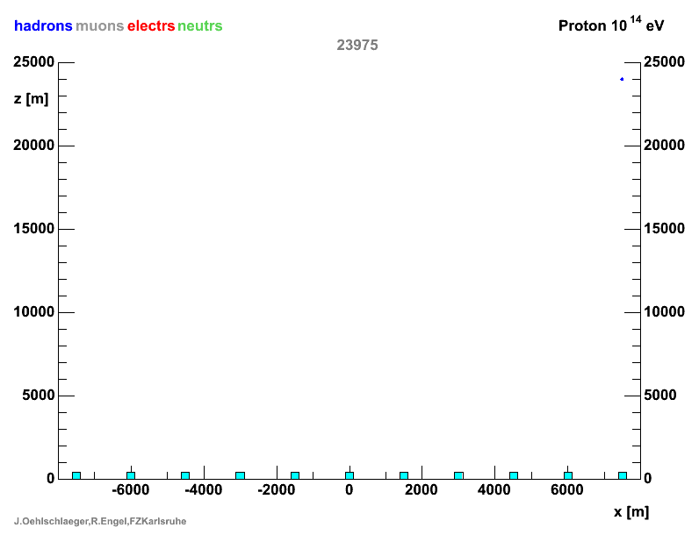
Cosmic Rays
Cosmic rays are protons, helium nuclei, and heavier nuclei bombarding Earth from all directions, all the time
Earth’s atmosphere and Earth’s magnetic field protect us.
A cosmic ray hitting the upper atmosphere
Notes:
Optional: Cherenkov radiation

Slide 11
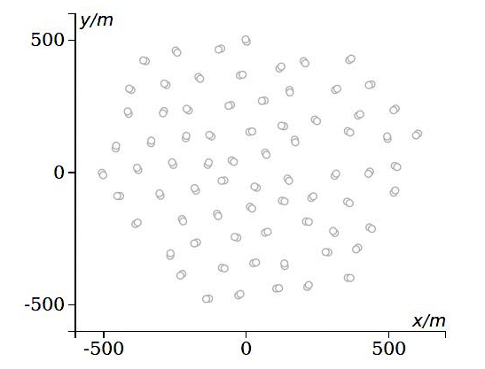
Detecting Cosmic Rays in IceTop
A cosmic ray detected by IceCube (IceTop)
Notes:
Optional: Cherenkov radiation

Slide 12
Schedule
9:15 – 9:30 Introduction
9:30 – 10:15 Particle detector challenge
10:20 - 10:55 Working and living at the South Pole
11:00 - 11:50 IceTop cosmic ray spectrum
11:50 - 12:50 Lunch
12:50 – 2:30 IceTop cosmic ray spectrum

